Slide 1
SECURE DATA HIDING IN IMAGES USING STEGANOGRAPHY
CAPSTONE PROJECT
Presented By: Pragya Bhardwaj
Student Name : Pragya Bhardwaj
College Name & Department : Banasthali Vidyapith (B.TECH. CSE)

Slide 2
OUTLINE
Problem Statement
Technology used
Wow factor
End users
Result
Conclusion
Git-hub Link
Future scope

Slide 3
Problem Statement
In today's digital world, secure communication is essential. While encryption can be intercepted, steganography hides messages inside images for extra security. This project uses Python and OpenCV to encode and decode hidden messages in images.

Slide 4
Technology used
LIBRARIES: CV2
OS
STRING
PLATFORM: Python 3.11.9

Slide 5
Wow factors
1. Steganography - Hiding Messages in Images
Instead of traditional encryption (text-to-text), this method hides the message within an image's pixel values.
This makes it nearly invisible to anyone inspecting the image with the naked eye.
2. Minimal Image Distortion
The message is stored within pixel color values (RGB), ensuring the image looks normal.
Unlike watermarking or QR codes, there is no visible clue that a secret message is inside.
3.Potential Real-World Applications
Cybersecurity & Data Privacy: Secret communication without drawing attention.
Digital Watermarking: Protects intellectual property by embedding invisible messages.
Secure File Transfers: Send hidden data disguised as ordinary images over insecure channels.

Slide 6
End users
Journalists & Activists - To securely communicate sensitive information while avoiding detection.
Cybersecurity Professionals - For research and implementation of secure data hiding techniques.
Forensic Experts - To discreetly embed crucial details within digital media for investigative purposes.
Military & Government Agencies - For confidential message storage and secure transfer of critical intelligence.
Privacy Enthusiasts & Researchers - Individuals interested in cryptography and experimenting with secure data embedding.
Students & Educators - Useful for academic projects and understanding real-world cryptographic applications.

Slide 7

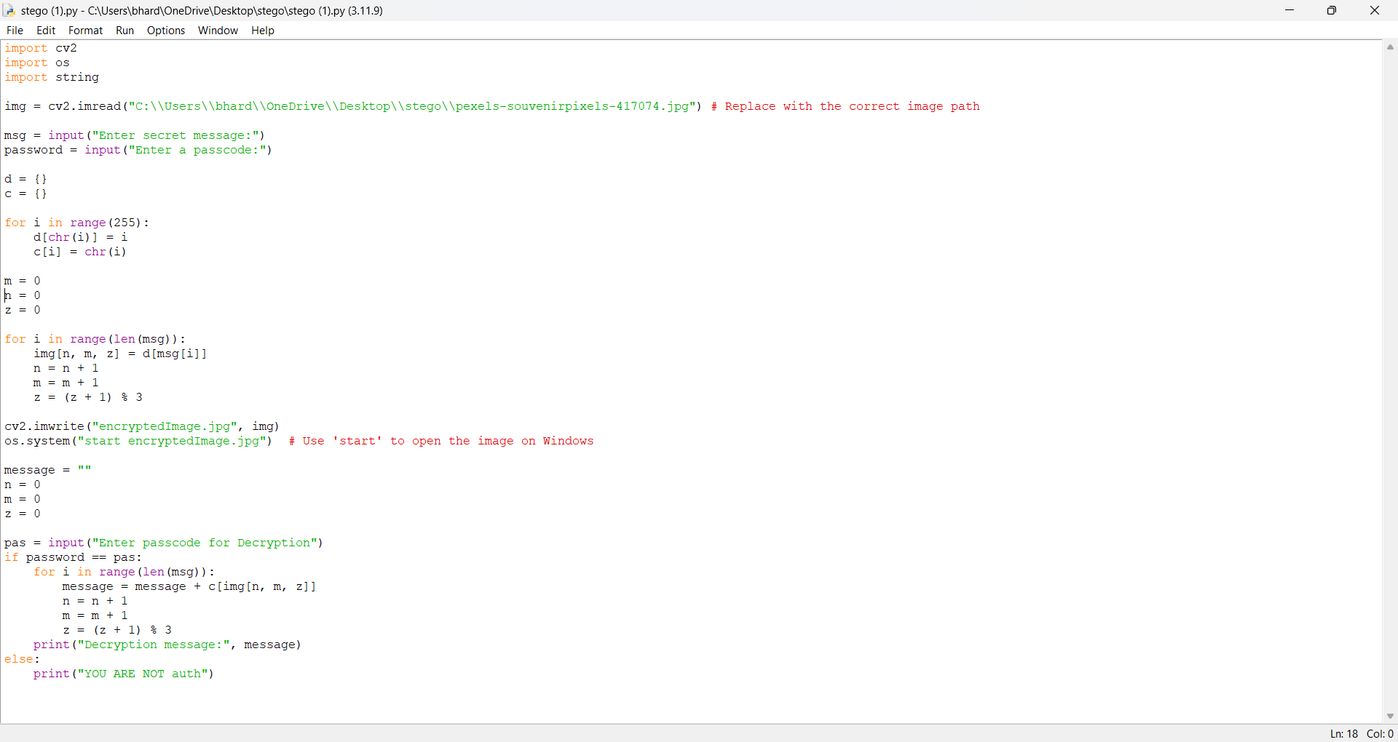
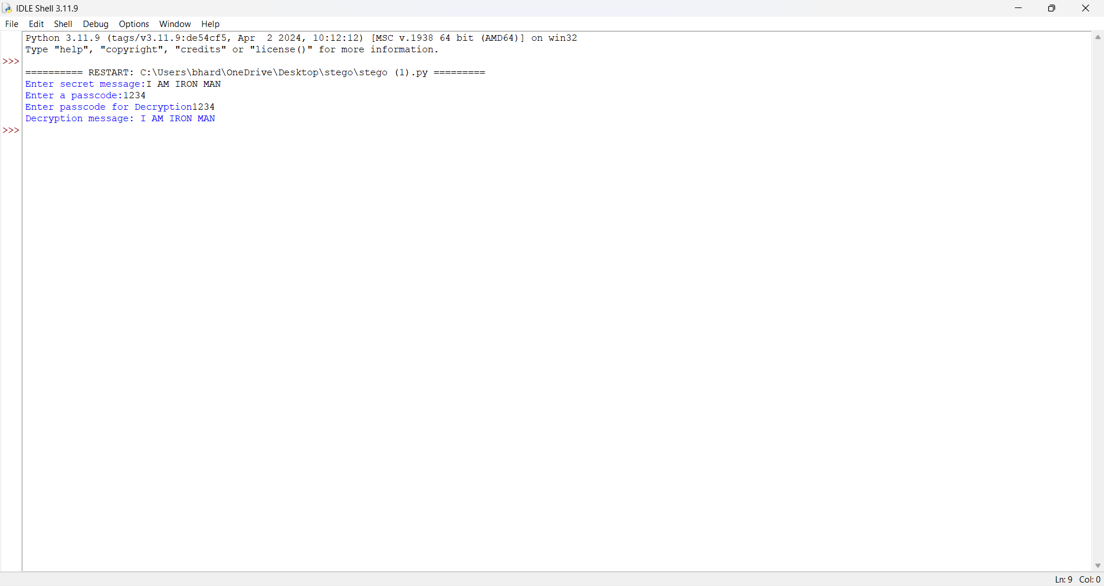
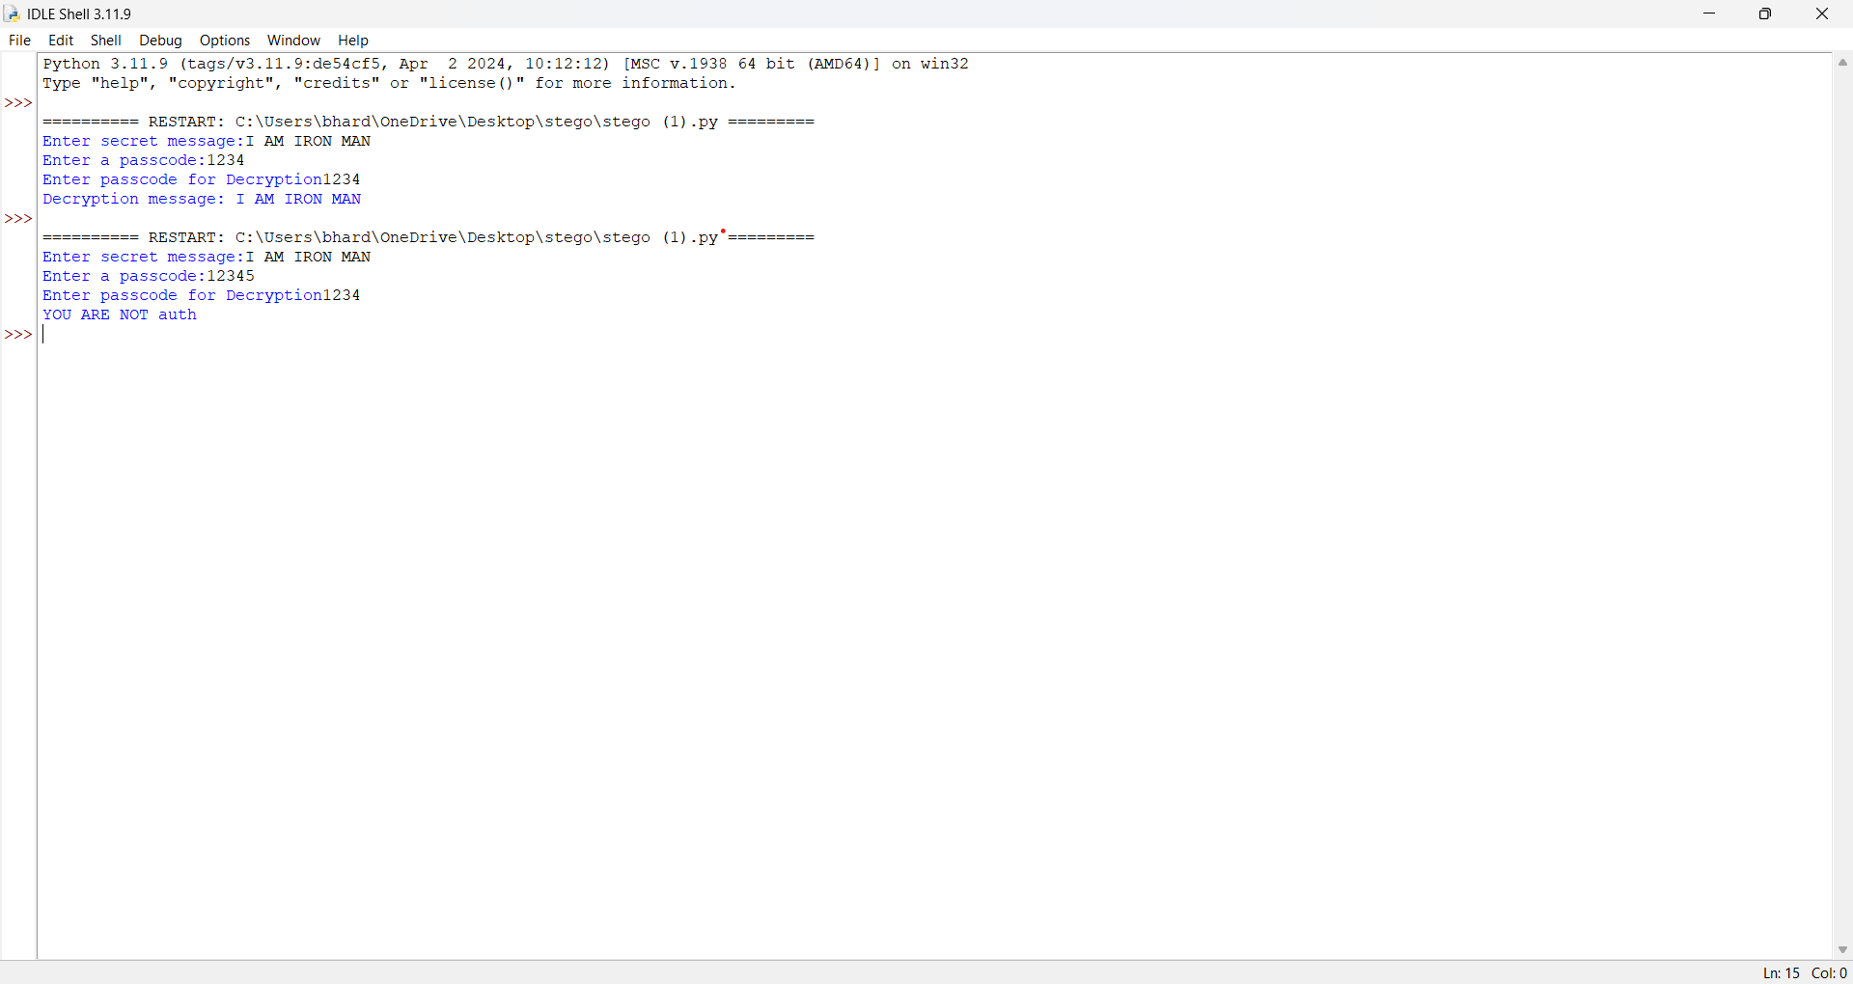
Results

Slide 8
Conclusion
The Image-Based Encryption & Decryption project successfully demonstrates a secure and innovative method for hiding messages within images using pixel manipulation. By leveraging password-protected decryption, it enhances the confidentiality of sensitive data and provides a simple yet effective alternative to traditional cryptographic methods.
This project highlights the potential of steganography in secure communication, ensuring that private information remains concealed within everyday digital media. With further enhancements, such as integrating advanced encryption techniques, this approach could become a practical solution for real-world cybersecurity applications.

Slide 9
GitHub Link
https://github.com/Pragya-Bhardwaj/IBM-SKILLSBUILD.git

Slide 10
Future scope(optional)
Enhancing security using Least Significant Bit (LSB) Steganography.
Supporting multiple file formats for broader applications.
Adding AES encryption before embedding text into the image.
Mobile & Web app integration for wider accessibility.

Slide 11
THANK YOU

